Slide 1
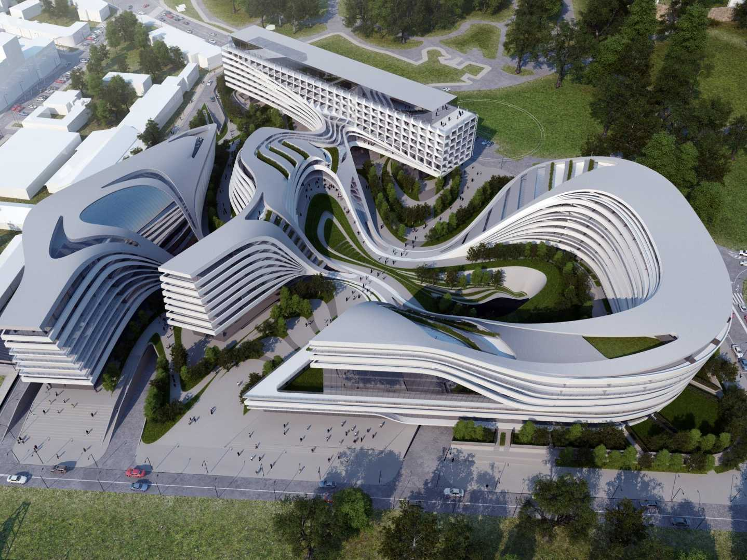
Data Virtualization
PDTool Training
PDTool Studio Version Control
Presenter
Title
Notes:
Hello, and welcome to the PDTool Training course for Data Virtualization, or DV.

Slide 2
Agenda
Basic Information
Advanced
Topologies
Details
Notes:
We begin this module by examining the basic concepts of PDTool and how it will be used.

Slide 3
Basic Information
© Copyright 2000-2017 TIBCO Software Inc.
Notes:
Next, let’s examine some common deployment options for DV.

Slide 4
PDTool Studio Basic Information
PDTool Studio VCS Support
Subversion
Microsoft Team Foundation Server (TFS) 2010 – 2013 (TEE 11.0 required)
Perforce
CVS
PDTool Studio Version Control Operations
Check-in – provides the ability to check-in individual DV resources from DV into a VCS using DV Studio.
Check-out – provides the ability to check-out DV resources from VCS using DV Studio.
© Copyright 2000-2017 TIBCO Software Inc.

Slide 5
Version Control Benefits
Robust development process
Project evolution management
Change tracking
Checkpoints
Backtracking
Restore accidental deletion
Project scalability support
Distributed team development
Controlled resource sharing
© Copyright 2000-2017 TIBCO Software Inc.

Slide 6
Topologies
© Copyright 2000-2017 TIBCO Software Inc.
Notes:
Next, let’s examine various VCS topologies.

Slide 7

VCS Topology Basic Concept
PDTool Studio provides a bridge between DV Studio and VCS Repository
Diff/Merger
DV Studio
DV Studio VCS Operation
Workspace initialized on each client computer
Determine difference between VCS and DV resources
Supported VCS repository and client software [svn, tf.cmd, p4, cvs]
© Copyright 2000-2017 TIBCO Software Inc.
Notes:
DV Repository is the master in this scenario because it is always the most current version of the DV objects. It is different than what most developers are used. When it comes to version control most developers think of the VCS as the master repository and their file system as the local development workspace. However, with DV Studio it is connected live with the DV repository and any modifications to the code are immediately available to all DV Studio developers. The VCS repository servers as the slave. It’s purpose in life provides the following functions:
Provides a record of releases
Provides a staging area to deploy releases to a target DV server
Provides a backup of resources on an individual basis so that if resource(s) are accidently deleted, it is possible to retrieve individual resources.
Provides a facility to perform a difference between releases and report on changes.
What it does no provide:
DV Studio does not provide a graphical interface like Eclipse to merge differences in code.
DV does not provide its own versioning and therefore can only contain the latest version of code at any given point in time.

Slide 8

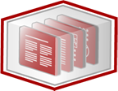


VCS Topologies (Single-Node)
Single-Node Topology
DV Studio Resource Definition
Check In
Write
Check Out
Read
VCS Repository
DV Studio
DV Repository
© Copyright 2000-2017 TIBCO Software Inc.
Notes:
DV Studio and DV Repository reside on the same machine and communicate with a VCS Repository either locally to the machine or remotely.

Slide 9
VCS Topologies (Multi-Node)
Multi-Node Topology
DV Studio Resource Definition
Write
DV Studio Resource Definition
Read
DV Repository
DV Studio
Check In
Write
Check Out
Read
VCS Repository
DV Studio
DV Repository
Write
Read
DV Studio Resource Definition
DV Repository
DV Studio
© Copyright 2000-2017 TIBCO Software Inc.
Notes:
There are multiple DV users each having DV Studio and DV Repository reside on their machine. Each user communicates remotely to a VCS Repository. This is not an ideal scenario as there can be collisions on code being checked in. This requires a high degree of developer coordination.

Slide 10
VCS Topologies (Multi-User Direct)
Multi-User Topology (Direct VCS Access)
DV Studio Resource Definition
Read
Check In
Write
Check Out
DV Studio
DV Studio Resource Definition
Read
Check In
DV Repository
Write
Check Out
DV Studio
VCS Repository
DV Studio Resource Definition
Read
Check In
Write
Check Out
DV Studio
© Copyright 2000-2017 TIBCO Software Inc.
Notes:
The multi-user direct scenario is more typical of the DV user base. This represents a shared DV environment where the developers have DV Studio on their machine. In this scenario each developer also has PDTool Studio installed to provide the bridge between DV Studio and the VCS repository.

Slide 11
VCS Topologies (Multi-User Managed)
Multi-User Topology (Managed VCS Access)
DV Studio Resource Definition
Read
Check In
Write
Check Out
DV Studio
DV Studio Resource Definition
Read
Write
DV Repository
DV Studio
VCS Repository
DV Studio Resource Definition
Read
Write
DV Studio
© Copyright 2000-2017 TIBCO Software Inc.
Notes:
The multi-user managed scenario is a derivation on the “direct” approach where the responsibility of check-in/check-out falls to a small group of development release managers. They are responsible for checking in code at release time.

Slide 12
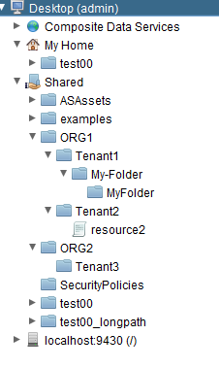
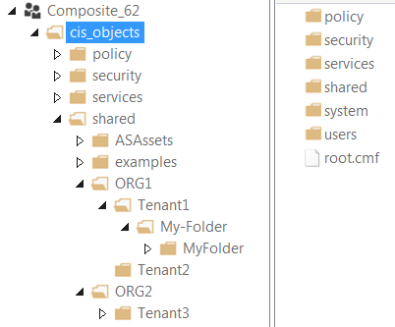
VCS Topologies (Multi-Tenant)
Multi-Tenant VCS Topology
DV Studio Resource Definition
Read
PDTool Studio scripts
/PDToolStudio70
/SVNsw (subversion workspace)
/TFSsw (TFS workspace)
Write
Check In
DV Studio (Tenant 1)
Check Out
VCS Repository
TFS, Subversion…
DV Studio Resource Definition
Read
Write
DV Repository
DV Studio (Tenant 2)
DV Studio Resource Definition
Read
Write
DV Studio (Tenant 3)
© Copyright 2000-2017 TIBCO Software Inc.
12
Notes:
The multi-tenant topology provides for a strategy where DV is being used by multiple tenants. The goal is to provide the flexibility where targeted DV tenant folders are checked into the VCS repository without having to check-in the entire DV repository. This strategy also allows the use of multiple VCS repositories of the same or different types. It allows for some tenants not to use VCS at all if they wish.

Slide 13
Details Section
© Copyright 2000-2017 TIBCO Software Inc.
Notes:
Next, let’s examine some common deployment options for DV.

Slide 14
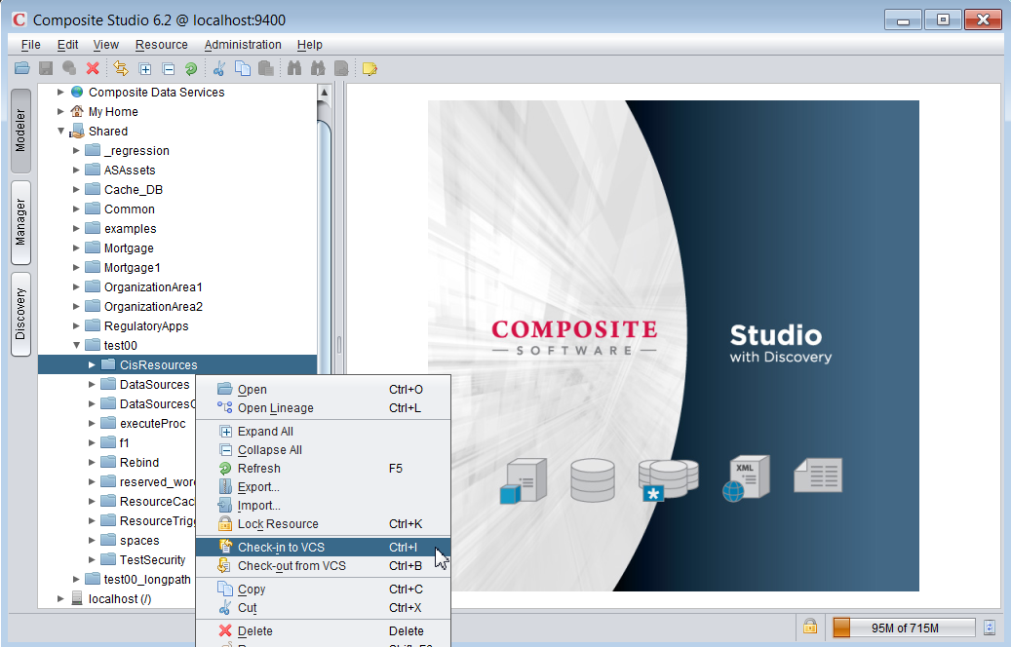
DV Studio: Operations
Check-in
Check-out
15
© Copyright 2000-2017 TIBCO Software Inc.

Slide 15
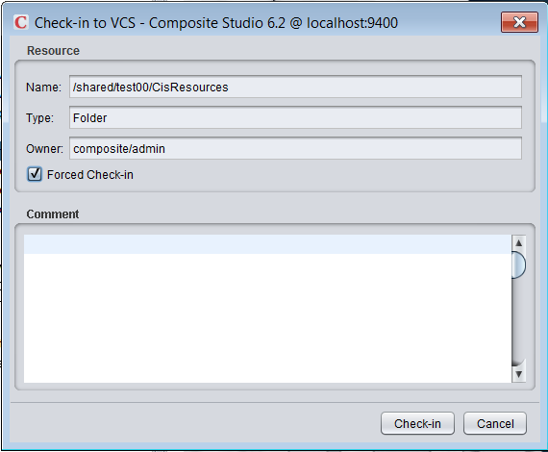
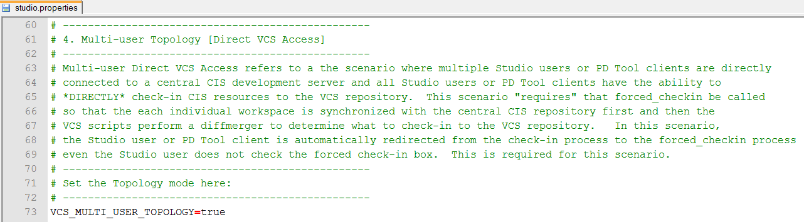
DV Studio: Check-in
Check-in – Compare with local workspace as is without synchronizing with VCS
Forced Check-in – Force synchronization of workspace from VCS and DV before comparing.
PDTool Studio: studio.properties variable – VCS_MULTI_USER_TOPOLOGY=true
Forced Check-in box is checked
© Copyright 2000-2017 TIBCO Software Inc.

Slide 16
PDTool Studio: Workspace
Workspace Concepts
Workspace – Used for checking in/out resources to/from VCS.
Resources checked out from VCS are individual .cmf files
Temporary workspace – Used for importing/exporting resources to/from a target DV server.
Resources are exported as individual .cmf files
© Copyright 2000-2017 TIBCO Software Inc.

Slide 17
DV Studio: Resource to VCS Mapping
DV Resource Types DV → VCS Mapping
Containers (Folder, Catalog, Schema) myFolder → myFolder.cmf
Data sources myDS → myDS.cmf
Definition sets myDefSet → myDefSet_defintions.cmf
Links (published services) myView → myView_link.cmf
Procedures (SQL Script, XQuery, XSLT, etc.) myProc → myProc_procedure.cmf
Tables (Relational Table, View, Flat File, etc.) myView → myView_table.cmf
Trees (XML Files) myXML → myXML_tree.cmf
Triggers myTrigger → myTrigger_trigger.cmf
© Copyright 2000-2017 TIBCO Software Inc.

Slide 18
DV Studio: CMF Resources
CMF Files (Composite Metadata File)
XML formatted file for each resource – XML does not guarantee order
Resources with underscores –
e.g. my_resource → my__resource
Non-Alphanumeric [spaces, comma, etc.] – encoded with underscore + 4 digit hex code.
e.g. “my folder” → my_0020folder.cmf
Case insensitive files systems (windows) yields unexpected results when different resources in same DV namespace have the same name.
*** DO NOT DO THIS WHEN USING VCS ***
DV: Res1 [folder] and Res1 [data source] in same folder
DV: RES1 [table] and res1 [table] in same folder (or any combination of case)
© Copyright 2000-2017 TIBCO Software Inc.

Slide 19
DV Studio: CMF Resource Content
Identification (name, type, version)
Interface (input types, output types)
Constraints (identity, referential)
Implementation (body, definition)
Dependencies
Validation assessment
Configuration settings
Security settings
Caching settings
Statistics settings
Studio model
User-defined annotation
© Copyright 2000-2017 TIBCO Software Inc.

Slide 20
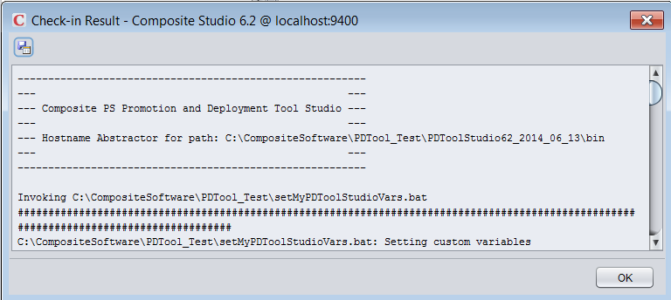
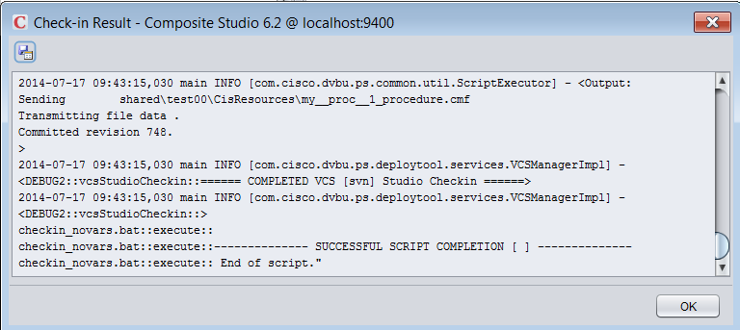
PDTool Studio: Logs
Top of the Pop-up Log
Logs
PDToolStudio/logs
app.log – provides a rolling log of executions
Bottom of the Pop-up Log
© Copyright 2000-2017 TIBCO Software Inc.

Slide 21
DV Resources That Don’t Get Checked In
Studio resources
Not amenable to versioning
Built-in (e.g. /lib, /services/databases/system)
Non-Studio resources
Connectors
Stored under /system/connector/…
Server configuration files
Binary files
CJP jars, DB driver jars, …
© Copyright 2000-2017 TIBCO Software Inc.

Slide 22
DV Studio: Security
Check-in and checkout processes are DV security sensitive
DV authentication required
DV authorization rules applied
Check-in by a certain DV user applies only to those DV resources that are read-accessible by that user
Check-out by a certain DV user may be performed if all the resources being checked out are write-accessible by that user
© Copyright 2000-2017 TIBCO Software Inc.

Slide 23
Advanced Section
© Copyright 2000-2017 TIBCO Software Inc.
Notes:
Next, let’s examine some common deployment options for DV.

Slide 24
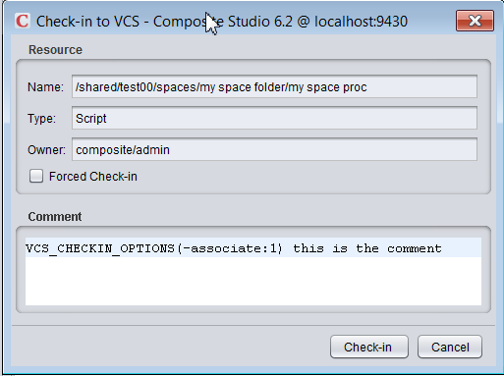
PDTool Studio: Check-In Options
Required Check-in commands
Added into PDTool Studio check-in comments
VCS_CHECKIN_OPTIONS(vcs-command)
E.g. “VCS_CHECKIN_OPTIONS(-associate:1) check-in comment”
This example shows how to infuse a TFS command which associates a work item task id with check-in of some code.
© Copyright 2000-2017 TIBCO Software Inc.

Slide 25
PDTool Studio: Multiple DV Server Support
Supports multiple DV servers from the same installation
Scenario 1 – Same DV server using multiple VCS
A developer who is working on different projects in a shared DV server and needs to check-in code for one project into one VCS (e.g. subversion) and also check-in code for another project into a different VCS (e.g. TFS).
Scenario 2 – Different DV servers using same or multiple VCS
A developer who is working on the primary development server and needs to check-in code to VCS. The same developer is working on a “maintenance” DV server and needs to check-out and check-in code to a different VCS branch.
© Copyright 2000-2017 TIBCO Software Inc.

Slide 26
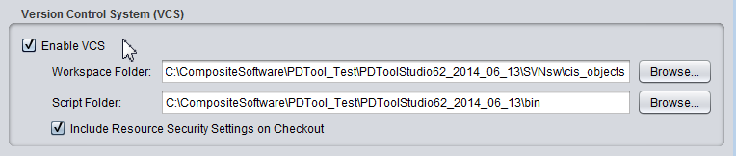
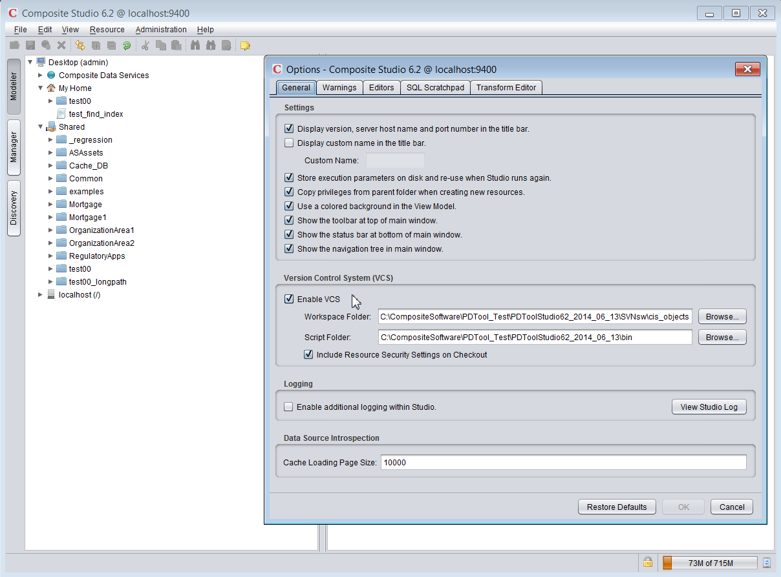


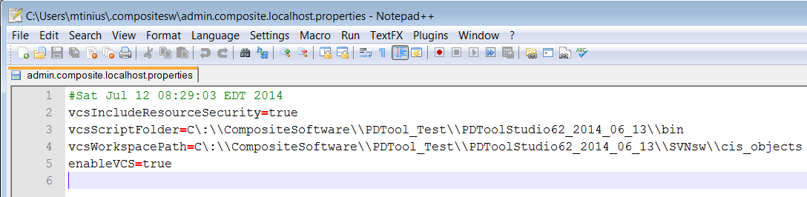
DV Studio: Configure Multiple DV Servers
DV Login: user=admin, domain=composite, host=localhost
DV Studio → Edit → Options
Saved as C:\Users\%USERNAME%\.compositesw\USER.DOMAIN.HOST.properties
© Copyright 2000-2017 TIBCO Software Inc.

Slide 27
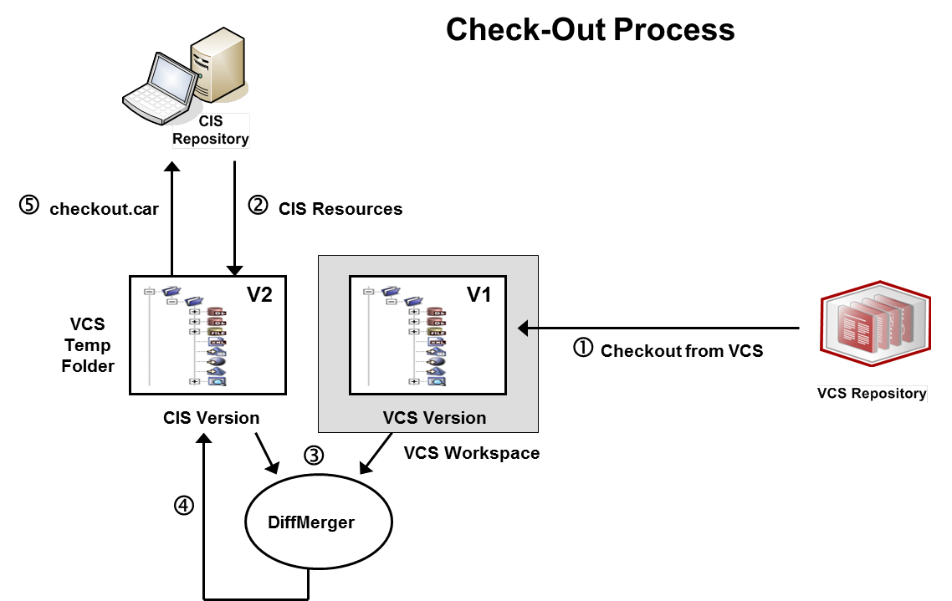
PDTool Studio: Check-Out
PDTool Studio Version Control Check-out Operation
© Copyright 2000-2017 TIBCO Software Inc.
Notes:
The check-out process shown in the illustration involves these steps:
A current snapshot of the specified DV resources is obtained from the VCS workspace (V1).
The current version of the same resource subtree in DV is captured into the VCS temp folder (V2).
The DiffMerger batch script is applied against the DV and VCS versions to compute V1-V2. V1-V2 captures the required modifications (that is resource creations, updates or deletions) required to convert subtree V2 into V1.
The DiffMerger batch script is applied to V2, using as input V1 and V1-V2, to modify the contents of subtree V2, so that they match the contents of V1 and package all resource changes in a checkout.car file.
The checkout.car file is imported into DV repository.
The VCS Workspace is cleaned up; V2, the checkout.car file, and the V1-V2 results are deleted.

Slide 28
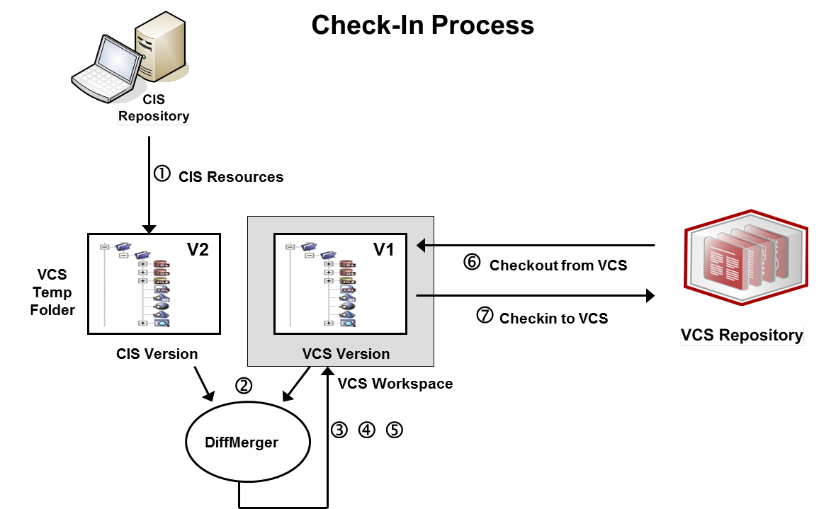
PDTool Studio: Check-In
PDTool Studio Version Control Check-in Operation
© Copyright 2000-2017 TIBCO Software Inc.
Notes:
The check-in process shown in the illustration involves these steps:
The current version of the same resource subtree in DV is captured into the VCS temp folder (V2).
The DiffMerger batch script is applied against the DV and VCS versions to compute V2-V1. V2-V1 captures the required modifications (that is resource creations, updates or deletions) required to convert subtree V1 into V2.
The VCS-specific pre-processor in the Lifecycle Listener is applied on V1, using as input V2 and V2-V1, to prepare the workspace V1 for the application of the modifications described in V2-V1.
The DiffMerger batch script is applied to V1, using as input V2 and V2-V1, to modify the contents of workspace V1, so that they match the contents of V2.
The VCS-specific post-processor in the Lifecycle Listener is applied on V1, using as input V2 and V2-V1, to prepare the workspace V1 for checking into the VCS.
A current snapshot of the specified DV resources is obtained from the VCS workspace (V1).
V1 is checked into the VCS.
V2 and V2-V1 are deleted.

Slide 29
PDTool Studio: Forced Check-In
PDTool Studio Version Control Forced Check-in Operation
© Copyright 2000-2017 TIBCO Software Inc.
Notes:
The check-in process shown in the illustration involves these steps:
The check-in process shown in the illustration involves these steps:
A current snapshot of the specified DV resources is obtained from the VCS workspace (V1).
The current version of the same resource subtree in DV is captured into the VCS temp folder (V2).
The DiffMerger batch script is applied against the DV and VCS versions to compute V2-V1. V2-V1 captures the required modifications (that is resource creations, updates or deletions) required to convert subtree V1 into V2.
The VCS-specific pre-processor in the Lifecycle Listener is applied on V1, using as input V2 and V2-V1, to prepare the workspace V1 for the application of the modifications described in V2-V1.
The DiffMerger batch script is applied to V1, using as input V2 and V2-V1, to modify the contents of workspace V1, so that they match the contents of V2.
The VCS-specific post-processor in the Lifecycle Listener is applied on V1, using as input V2 and V2-V1, to prepare the workspace V1 for checking into the VCS.
V1 is checked into the VCS.
V2 and V2-V1 are deleted.

Slide 30
Q&A
© Copyright 2000-2017 TIBCO Software Inc.
Notes:
Next, let’s examine some common deployment options for DV.

Slide 31
Extra Slides
© Copyright 2000-2017 TIBCO Software Inc.
Notes:
Next, let’s examine some common deployment options for DV.

Slide 32
PDTool Studio VCS Configuration Process
Prepare VCS Repository (admin)
1
Install
PD Tool for Studio
2
Configure VCS Environment Properties
3
VCS specific
VCS specific
4.1
Initialize VCS Workspace
4.2
Initialize VCS Base Folders (admin)
Enable
VCS in Studio
5
6
Test VCS
© Copyright 2000-2017 TIBCO Software Inc.
Notes:
Prepare VCS Repository – an administrator uses native VCS tools to create a “repo” for DV to check-in resources.
Install PDTool Studio – install according to installation instructions
VCS command line utility must be installed on same machine.
Configure VCS Environment Properties – properties may be configured in one or all of environment batch files, studio configuration property files.
4.1 Initialize VCS Workspace – executing VCS Init initializes the local workspace with what is in the VCS system. This is a pre-requisite to using VCS.
4.2 Initialize VCS Base Folders – this is a one-time, optional operation performed by an admin in a multi-tenant environment where only certain folders will be checked in under version control. This alleviates having to check-in the entire DV repository which could be quite large.
5. Enable VCS in Studio – enable VCS using the “Edit, Options” menu. This pop-up window provides a way to configure where the workspace folder and PDTool script folder is located.
7. Test VCS – test check-in, check-out and forced check-in capabilities from studio on a single resource and then on a folder with a small number of resources.

